Slide 1
Framing A Psychosocial Strategy to Climate Change
Abbey Strauss, MSW, MD.
Boca Raton, Florida
Spring 2024

Slide 2
Framing A Psychosocial Strategy to Climate Change A Dialogue Of Our Roles
- This is not about if climate change is occurring.
- This is about thinking of climate change’s impact on all of us.
- We are victims of climate change the same as those we treat.
- What we give others needs to be taken in by ourselves as well.
- Many traditional psychotherapeutic and medico-therapies help but this process has a different endpoint.

Slide 3
The characteristics of climate related fears and anxieties.
Some of it is man-made, and some of it is a natural process.
Some of it may be mitigated, some of it might have been mitigated if we acted earlier and with less politics, and some of it cannot be mitigated.
None of it is avoidable, regardless where we live, our religions, or how much money we have, etc.
All of it, in terms of the impact on our lives, will require all of us to make significant behavioral shifts. Response is also preparation for what will come.
The therapeutic and community endpoint is to develop resiliency and mitigations to a problem that is not ultimately resolvable. We must learn to acclimate to a new relationship to earth.
It’s hard but necessary to prepare lifejackets that we might never need.

Slide 4
What Are Our Goals As We Prepare To Treat Others
What is the origin of the anxiety? What is the treatment endpoint?
Are we treating to lower the triggers or to lessen the responses?
When and if should medications be used for the mental health?
What treatment model should be used – CBT, DBT, EMDR, insight psychotherapy, pastoral, resilience training, desensitization, anger management?
Can we introduce reality and avoid panic?
Consider comorbid issues – egocentrism, personality issues, fragile egos, substance abuse, OCD, immaturity, real financial or job issues, religious issues, denial, thought disorders, etc.
How to handle those who have deeper existential fears?

Slide 5
The deeper questions..
What are our expectations of earth’s work load ability? Are are finally living the results of exhausting its resiliency? Can the earth support our population and expectations to support our needs and pleasures?
Do we have to wait for the earth to recycle itself and so go through it’s natural cycles?
Do we really believe that a few years of living a greener life, and perhaps better carbon or other sinks, will produce that different a end product?
Are we working to maintain a new lifestyle, or is it to re-achieve the older and less climate change compulsory lifestyles?
The ennui factor: “are we too late? Or is the best we can do is to maybe slow it up a little?”

Slide 6
Avoiding the Rube Goldberg pitfalls
A "machine“ (or treatment model) is often presented on paper that would be impossible to implement in actuality.
Many therapy models exist. Some of them may be Goldberg machines when dealing with climate change.
One universal impediment is when too much confidence rests that legislation will repair or prevent, even if it is often possible to implement.
The Goldberg model is prevented when people make real personal changes. The healthy tsunami builds from the bottom up and not the top down, though it helps if the top executes the same goals. Good leaders must pollinate the bottom-up undertaking.
We must prevent Goldberg models.

Slide 7
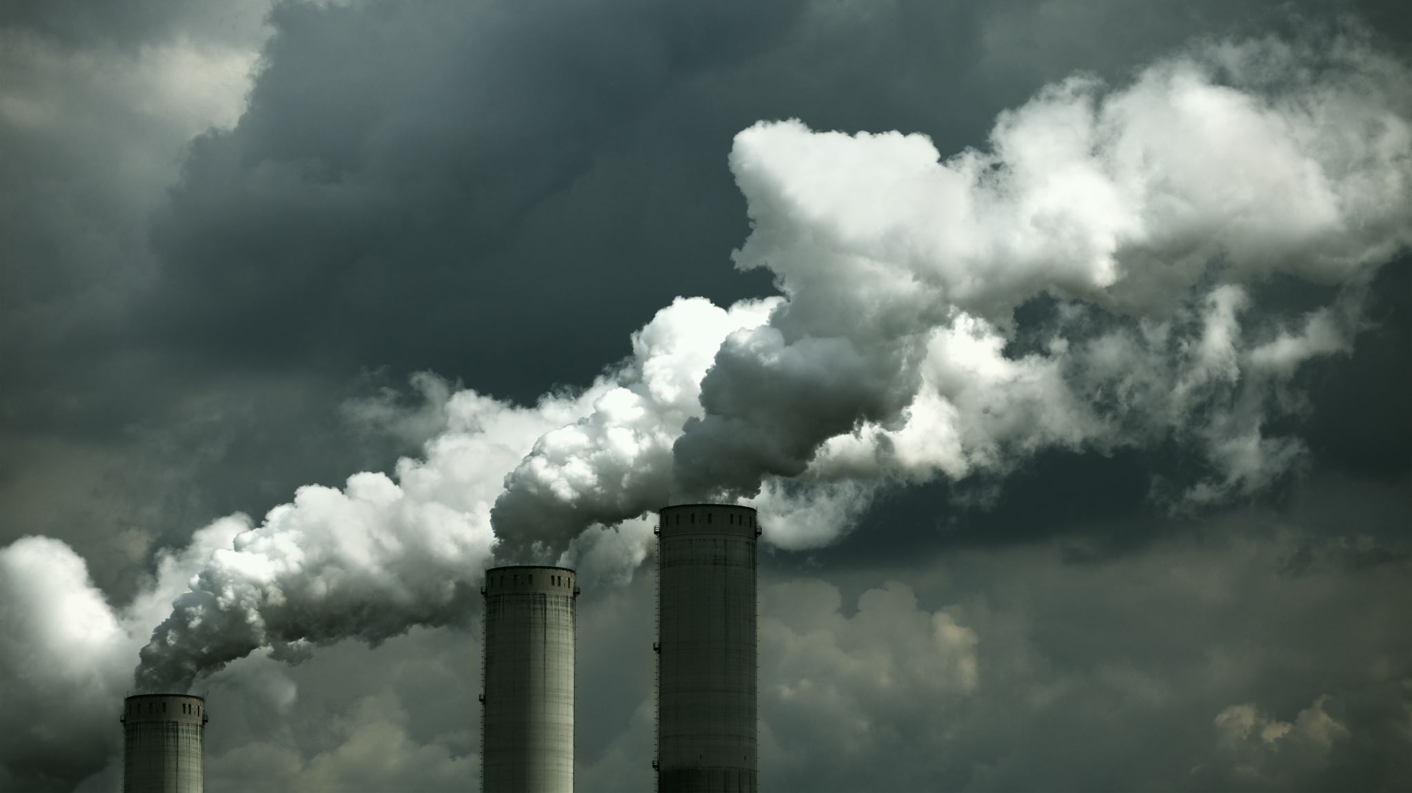
Solastalgia
Coined in 2005 by Glenn Albrecht.
From Latin sōlācium (comfort) and the Greek root -algia (pain, suffering, grief) -- emotional or existential distress caused by environmental changes. It currently applies to pollution, storms, cooling, warming, deforestation, etc., but it could be used more generally.
Might this become a ICD-10 code limited to climate change?

Slide 8
Eco-anxiety- Some Basic Numbers
The term eco-anxiety is said to have been coined by Glenn Albrecht.
It is defined as "a chronic fear of environmental doom.”
The American Psychological Assocation defines eco-anxiety as "the chronic fear of environmental cataclysm that comes from observing the seemingly irrevocable impact of climate change and the associated concern for one's future and that of next generations".
In 2018, U.S. surveys found between 21% and 29% of were "very" worried about the climate. The rate is double the rate of a similar study in 2015.

Slide 9
More Eco-anxiety Statistics
A survey published in Lancet (Sept 2021) of 10,000 young people from 10 countries found that almost 60% were very or extremely worried about climate change. Two thirds were sad, afraid and anxious. Close to 40% were hesitant to have children.
Women (45%) are more likely to report eco-anxiety then men (36%)

Slide 10
More Psychological Thoughts About Climate Change
A 2022 American Academy of Sleep Medicine study reported that "anxieties around climate change and environmental issues" caused insomnia for 70% of Americans.” (That seems high.)
Similar suggested conditions are ego-grief, (or eco-depression), eco-anger, eco-guilt.
Treatment tends to be more successful with the ability to ponder, and then pilot, across the challenges. We must access that aptitude so to not induce failure, ennui, or nihilism.

Slide 11
Two important psycho-philosophic terms
Ennui – (French) - A feeling of languor, weariness, no interest perhaps from endless failure, disappointment, sometimes boredom, deep lost with no known corrective options, disgust, no passion. Often precedes suicide.
Nihilism – (Latin for nothing) – Nietzsche: disintegration of traditional morality, to a meaningless or purposeless of life. That human nature will become so selfish and chaotic to cause irreverable climotoxicity.

Slide 12
A more common - and perhaps less painful way - to look at all of this:
Not a one of this has escaped the need for preventive maintenance of our cars, air conditioners, boats, pools, roofs, etc. We now desperately need more preventive maintenance of our world and psyches. It is a sense of commitment to each other, etc., to keep our lifestyles alive. Some people would say it is the maintenance of our relationships and soul, to ourselves and to the earth.
The problem is that when we don't do oil changes at a rate schedule, the car suffers. Then we suffer.
So, this is a massive project in preventive maintenance in the areas where the maintenance can or might still have a preventative result.

Slide 13
Some basics we are expected to know
Back to basic science. We too often treat the symptoms more than the origin – this takes away from our treatment depths and effectiveness. We need ->
Psychological basic science and theory, and also the theories of therapy types, i.e., which ones do we use?
Biological basic science – what, how, and why is the climate changing?
Back to religion-economics-political science. Patients hear what is not being done. How do we deal with their reactions to that?
Look at ourselves – how much of what we give to patients have we done to ourselves? What are we being true to if we drive a gas guzzler? Or leave the lights on, etc. Have we changed behaviors before we ‘treat’ others to do so? What do we really believe?

Slide 14
For Example – a discussed and current Political-Science Pretenses
Every year, since 1995, the Conference of Parties (COP) gathering has been the key forum for international cooperation on climate action. Last year – 2023 - the United Arab Emirates (UAE) hosted the 198 nations that are parties to the United Nations Framework Convention on Climate Change. The elected president of this COP28 is the CEO of a fossil fuel company - His Excellency Dr. Sultan Al Jaber.

Slide 15
Jaber - a member of the UAE Federal Cabinet, Minister of Industry and Advanced Technology, President of COP28, Group CEO of Abu Dhabi National Oil Company, and Chairman of Masder.
- How do we know that he is really on our side?
- Given the political climate, it makes it very difficult to reassure that corrective and mitigating efforts to deal with climate change are genuine.
- We therapists have to be aware of these very supra-geographical, political, economic, and other sociologic umbrellas under which we are trying to heal.
Skeptics until otherwise proven? Yes.

Slide 16
Anomie -- A Very Brief Introduction to Climate Change Sociology
Emile Durkheim, in 1897, in his book Suicide, used the term to reflect the malady of the infinite, because it was a desire without limit that can never be fulfilled; it only becomes more intense. He also called it an insatiable will.
Will climate change result in a social uprooting and dissolution of moral and other societal systems if the climate changes become too pressing?
Do we have a desire and expectation, without limit, of what the earth can and will do for us?

Slide 17
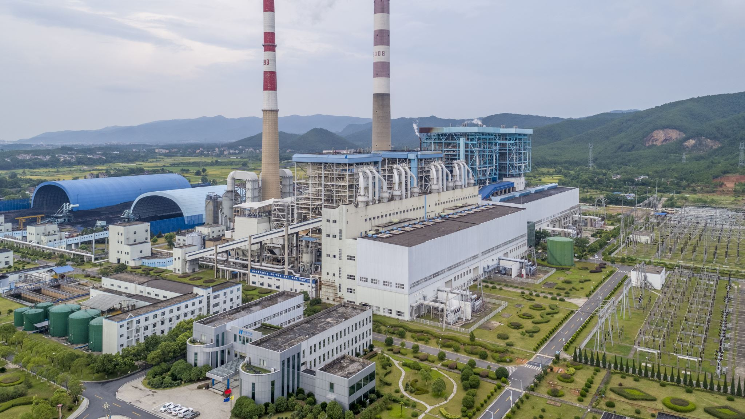
The Common Climate Change Causes and Influencers
Carbon Dioxide – e.g., fossil fuel use, deforestation
Methane –one ton warms equal to 86 tons of CO2
Population Size – People and Animals
Consumption Patterns – All forms of power and other material uses, with waste products
Natural orbital shifts, volcanic activity, forest fires, and regular weather fluctuations and ocean current shifts, independent but can also worsen by climate warming
Plankton, seaweed, permafrost, fungi, and other biological systems cause and help
Road and city paving, air conditioners, jet plane exhausts, other transporters, and large ships moving sea-life, etc.

Slide 18
“And if the earth is not ultimately a predictable and safe place to live the way I expect it to be… what happens to us?”
Basic pre-treatment questions we must ask ourselves:
Are we bringing too much existentialism into the therapy mode? Can patients handle it? Can we handle it?
Is unlabeled climate change induced existentialism by itself infiltrating into the psyches in manners we are not prepared to treat?
The world maybe permanent for our life spans, but not more. This uncertain mutability may be unnerving to many; how might this be discussed, and even prepared for, for all of us?
Are we misleading if we do not bring in the existential ticket?
How do my ego strengths compare to other peoples’ ego strengths?

Slide 19
Methane A Major Climotoxin
The Global Warming Potential of methane is 84-87, compared to CO2, which is 1.
NASA data – in 2019 total planet methane release = 590 tons, 360 of which were from manmade sources which include cattle (enteric fermentation), decomposing landfills, fossil fuels, coal mines, rice patties.
Burning methane reduces its climotoxicty by turning it into CO2, thereby reducing the warming impact equal to ~85 tons less of CO2 per methane ton.
So 360 million human made methane tons times 85 equals 3.06e9 less GWP CO2 equivalent tons. In a more visual format, that is 3,024,000,000 fewer tons of warming CO2.
US EPA estimates average automobile emits 4.6 tons of CO2 per year. The human methane release is therefore equal to 720,000,000 automobiles.
Atmospheric methane reduction may be a more rapid way to cool the earth.
Methane reduction is under widespread study.

Slide 20
Greenhouse Gases
Atmospheric methane and CO2 molecules absorb infrared radiation reflected from the sun warmed earth. The energy is released but the photons are often recaptured by other CO2 molecules. This is known as radiative forcing, and it adds to global warming. More CO2 means more molecules to continue to capture, and is a recycling, of sorts, of photons and heat. The heat then radiates down to earth.
Chemical bonds trap the energy, which would otherwise go into space. But methane very strongly holds the heat, more than CO2, so allowing heat to further accumulate.
Fewer molecules mean less heat can be captured, and so it is released back to space. The earth then cools.

Slide 21
What Do You Think?
Why would someone deny climate change given the data?
Why do people not think that they too need to make changes to help mitigate the problem? Perhaps they see it as the next generation’s problem, or that science will somehow figure it out, or that we are all doomed anyway, so why not just be a hedonist?
If these thought holders develop solastalgia, how do we approach it?
Sometimes the reality is not accepted until land sinks or agricultural systems change?

Slide 22
When and how do we non-fatalistically treat both the symptoms and the cause? The ennui risk
How to react that now we will probably not prevent the endpoint in the manner we want.
We must focus more on the degree of personal behavioral changes.
Talk about the earth’s workload, meaning our population size and our ongoing expectations to allow our unending pleasures?
How to we deal with the reality that things may have been less bad with earlier actions, and with less political control of the corrective process? “Why were they so political or short sighted or cheap about this?”

Slide 23
A few thoughts
For years, those of us making these warnings were ridicluded and called tree huggers, killjoys, spoilsports, pessimists, weak worry warts, etc.
Frame this denial in egocentric terms.
The three common steps to advancement – i.e., the real de facto ‘scientific method’ -
That’s impossible, wrong, or crazy.
Then, well, ok, that might make sense.
Finally, but of course, it’s so oblivious…why did we miss it?

Slide 24
Framing Climate Change – The 5 Tiers
The political system must endorse and legislate such that climate change necessities are not hindered by inadequate, archaic, mercenary, or short-term political policies and laws. Great care is needed to prevent or bravely reveal proffered projects that are actually political – scientific synthesis or pseudoscience.
The economic system must modify itself in concert with the realistic and necessary changes in the economy to accommodate climate change needs. Much of our economy rests on how we consume things. Laws will not necessarily change the activity or influence the economic tier.

Slide 25
Framing Climate Change –The 5 Tiers
3. There must be scientifically solid research to identify and falsify the proffering of all changes – human’s and nature’s – into our biosphere. Then we need solid and sound mechanisms to mitigate the human climate change impacts on the earth from our lifestyles.
4. Each of us must study and accordingly modify our own consumption patterns. It is often a matter of inconvenience, with perhaps some financial costs, to meet the requirements.
5. The community at large, and other proponents of our consuming and interactive lifestyles, must better understand the impact of climate change on all our routines, including ourselves. This includes the interim mental health realities of an existential change that cannot be stopped though it may be allyed.

Slide 26
Tier 5 Treatment Details to start
CPT Z-277 the issue is a response to environmental hazards – but not billable in Medicare
First treat any urgent concerns, preparing for heat waves, floods, etc.
Second, study and outline ways to meet longer and more complex core developments., perhaps with the same patient or groups.
Ecoanxiety a good term but needs acute, post-event and anticipatory sections.
Dealing with prospects of ‘too little too late’ needs real but gentle involvement.
Teach how to be in symbiosis with the earth. The earth will win, but that doesn’t mean we will lose.

Slide 27
Tier 5 Treatment – more Details
Usually passive, reticent, phobic, lazy, dependant or shy people may need initial psychological strengthening
Modify for learning disabilities, age, religious, cultural or political backgrounds
Consider the ‘political ecology’– political-social-economic factors mixng with climate issues.
Test for cynical, nilistic, and ennui occurrences.
Listen to concerns of water and food supply wars.
Listen to concerns about being out of control or anger at leaders.

Slide 28
Tier 5 Treatment – even more Details
Canvas for accurate data used for decision making. How to address inaccurate data? Teach the difference between opinion, fact, and egocentrism.
How effective can our treatment be if you have equal feelings? Can sharing this be safe and beneficial? Study the psychosocial dynamics to know if and how to share?
This ecoanxiety can be pre-traumatic and or post-traumatic.
Emphasize proportioned reducing or preventing behavioral changes.
Strengthen social pressure resilience that might come from doubters, even if the doubter has a controlling position in a person’s life. Teach diplomacy and how to learn from failure.
Teach social and other advocacy behaviors and involvements.

Slide 29
Tier 5 Treatment – a story
A patient with ecoanxiety complained to me that my treatment was akin to getting him to join the Army. I said yes.
I said just making him feel less anxious was wrong. I needed to train him to be properly grounded and to feel stronger. We all need to practice, be coached, and make mistakes.
Then, with new skills and tools, the bad anxiety could begin to reduce itself. The subsequent anxiety would not be just fear, but rather a healthy rechargeable battery to enhance and equip him to understand how to protect himself and his community.
It is all evenhanded, old fashioned psychotherapy. No fancy label. Just a different spin on the etiology, problem duration, global, political, and personal dimensions, and a distinctively, ever-shifting footprint as an endpoint. And we too have to do the things as the patients.

Slide 30
THANK YOU. QUESTIONS?
Through others we become ourselves.
Lev Vygotsky 1896-1934

